Slide 1


Name: Camellia Yi
IBM Data Science: Capstone Project
01/09/2026

Slide 2

Outline
Executive Summary
Introduction
Methodology
Results
Conclusion
Appendix

Slide 3
Executive Summary
Executive Summary
Objective: Predict SpaceX Falcon 9 launch success using historical mission data
Data Sources: SpaceX REST API and Wikipedia web scraping
Methods: EDA (Python & SQL), Folium maps, Plotly Dash, Classification models
Key Insights: Success rate increased steadily after 2013; payload mass and orbit type influence outcomes
Best Models: SVM (RBF) and Decision Tree with test accuracy ~83–93%
Outcome: Built an end-to-end data science pipeline with actionable insights
Methodology Overview
Data Collection: SpaceX API and Wikipedia scraping
Data Wrangling: Cleaning, encoding, feature engineering
EDA: Visualization and SQL analysis
Interactive Analytics: Folium maps and Plotly Dash
Predictive Modeling: Classification algorithms

Slide 4
Introduction
Introduction
SpaceX aims to reduce launch costs via reusable rockets
Understanding success drivers helps optimize mission planning
Problem: Can we predict launch success using mission, booster, and payload features?
Data Collection – SpaceX API
Used SpaceX REST API to retrieve launch records
Collected flight number, payload mass, orbit, launch site, and success outcome
Data stored and validated using Pandas
GitHub notebook included for reproducibility

Slide 5

Section 1

Slide 6
Executive Summary
Data Collection Methodology
Data Collection
Data was collected from two primary sources:
SpaceX REST API: Used to retrieve structured historical launch data including flight number, launch site, payload mass, orbit type, landing outcome, and mission success.
Web Scraping (Wikipedia): Supplementary data such as booster versions, landing pads, and reuse details were scraped using Python libraries like BeautifulSoup and pandas.read_html.
Data Wrangling & Processing
Data wrangling was performed to ensure consistency and usability of the dataset:
Removed irrelevant columns and handled missing values (e.g., payload mass).
Converted categorical variables into numerical format using One-Hot Encoding.
Standardized column names and data types.
Extracted year information from the launch date for time-series analysis.
Ensured all feature variables were numeric and cast to float64 for modeling.
EDA Using Visualization
Multiple visualization techniques were used to uncover patterns and trends:
Scatter plots to analyze relationships between payload mass, flight number, orbit type, and launch site.
Bar charts to compare success rates across different orbit types.
Line charts to observe yearly launch success trends. These visualizations revealed that higher flight numbers and certain orbit types (LEO, ISS, Polar) are associated with higher success rates.
EDA Using SQL
SQL queries were executed on an SQLite database to:
Aggregate payload mass by booster and agency.
Identify unique launch sites and filter launch records.
Rank landing outcomes over time.
Validate findings observed in visual EDA.

Slide 7
Executive Summary
Interactive Visual Analytics
Folium Maps
Interactive maps were built using Folium to:
Display global launch site locations.
Color-code successful and failed launches.
Analyze proximity of launch sites to coastlines, highways, and railways.
These maps added spatial context and helped explain why certain launch sites are strategically advantageous.
Plotly Dash Dashboard
A Plotly Dash dashboard was developed to provide interactive exploration:
Pie charts showing launch success counts.
Dropdowns to filter by launch site.
Range sliders to analyze payload mass vs. success outcomes.
This dashboard allowed users to dynamically explore launch performance patterns.
Predictive Analysis (Classification)
Several classification models were built to predict launch success:
Logistic Regression
Support Vector Machine (SVM)
Decision Tree
K-Nearest Neighbors (KNN)
Model Building, Tuning, and Evaluation
Data was split into training and testing sets with stratification.
Hyperparameters were optimized using GridSearchCV.
Models were evaluated using accuracy scores and confusion matrices.
The SVM (RBF kernel) and Decision Tree models achieved the highest test accuracy (approximately 83–93%).

Slide 8
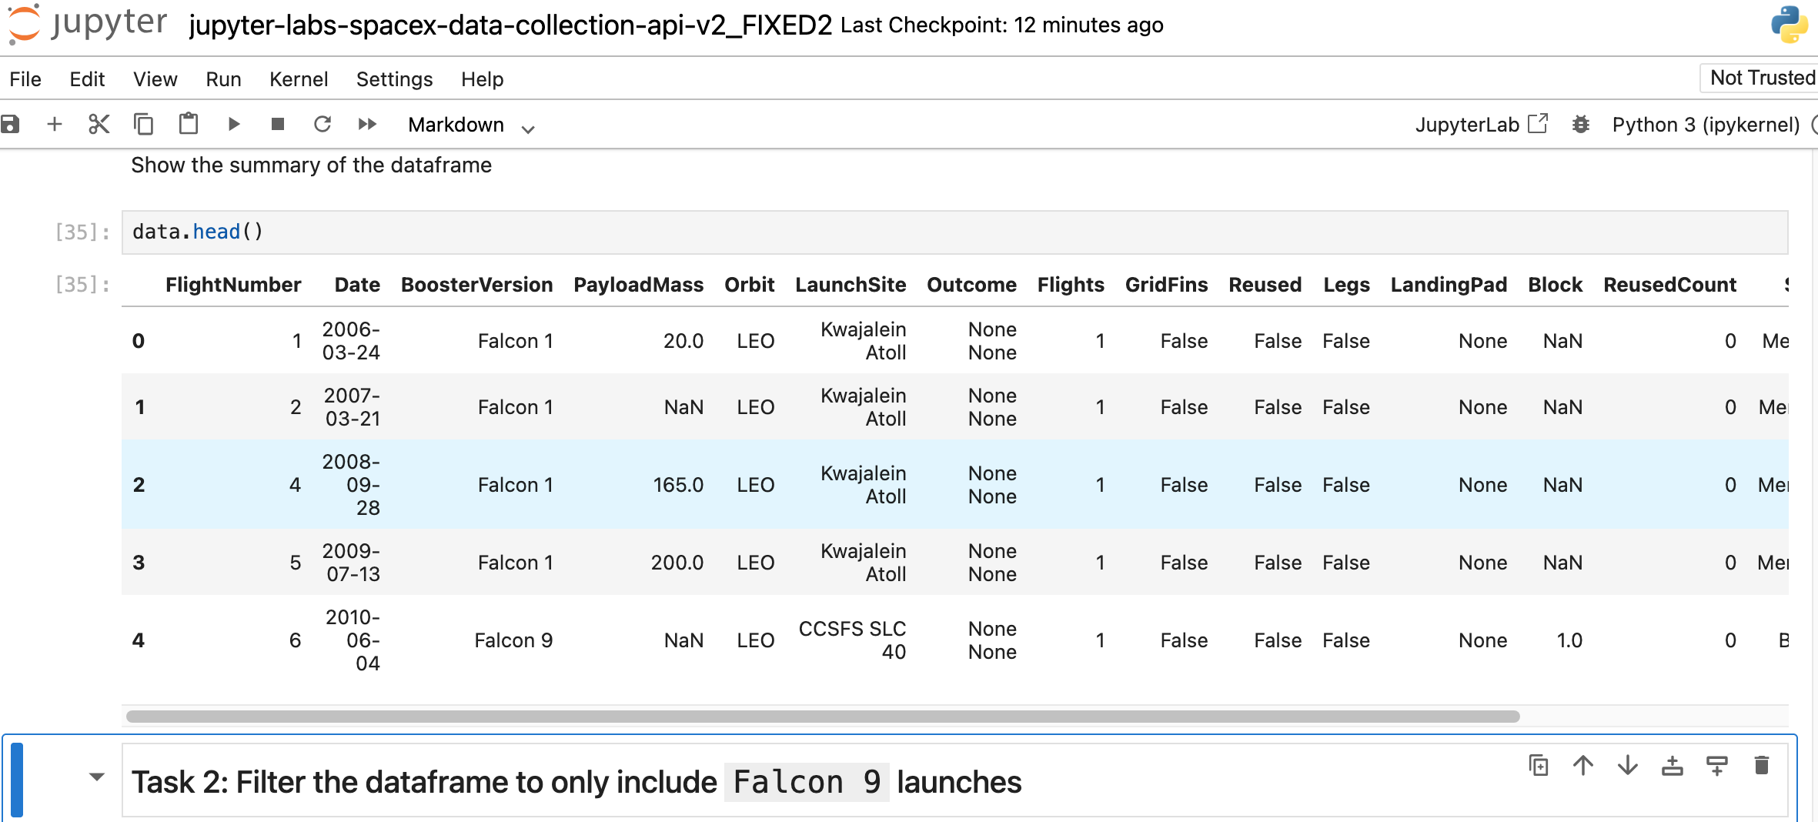
Data Collection
Data Sources
SpaceX REST API
Retrieved structured launch data
Fields included: Flight Number, Launch Site, Payload Mass, Orbit, Landing Outcome, Mission Success
Web Scraping (Wikipedia)
Extracted booster, landing pad, and reuse information
Used BeautifulSoup and pandas.read_html
Key Techniques
RESTful API calls using Python
HTML table extraction
Dataset merging using unique launch identifiers
Automated data retrieval for reproducibility

Slide 9
Data Collection – SpaceX API
Data Sources
SpaceX REST API Usage
Retrieved historical Falcon 9 launch data using SpaceX REST endpoints.
Collected structured mission attributes:
Flight Number
Launch Date
Launch Site
Payload Mass
Orbit Type
Landing Outcome
Mission Success (Class)
API Data Collection Flow
SpaceX REST API
│
▼
JSON Responses
│
▼
Parsed with Python (Requests + Pandas)
│
▼
Structured DataFrame
Key Techniques
RESTful API calls using Python
HTML table extraction
Dataset merging using unique launch identifiers
Automated data retrieval for reproducibility

Slide 10
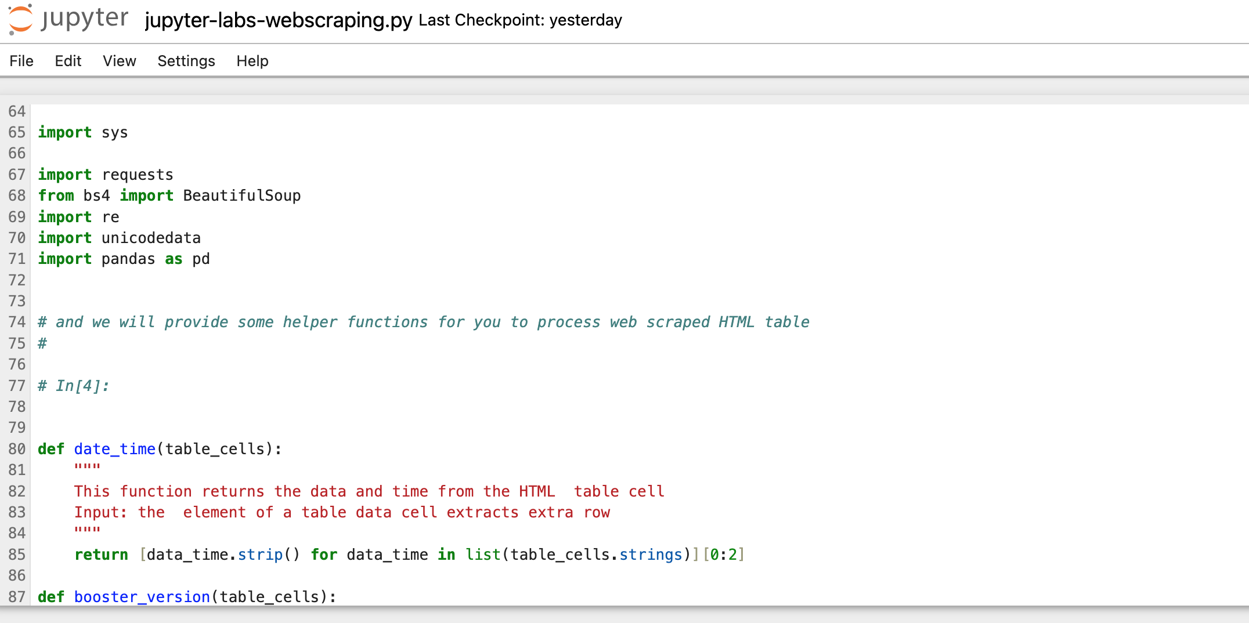
Data Collection - Scraping
Web Scraping Sources
Wikipedia Falcon 9 Launch Records
Supplemented SpaceX API data with:
Booster versions
Landing pads
Reuse and block information
Web Scraping Process
Wikipedia Web Pages
│
▼
HTML Tables
│
▼
Parsed with Pandas & BeautifulSoup
│
▼
Cleaned DataFrames
Key Techniques
HTML table extraction using pandas.read_html
Page parsing with BeautifulSoup
Data cleaning and formatting
Merging scraped data with API dataset

Slide 11
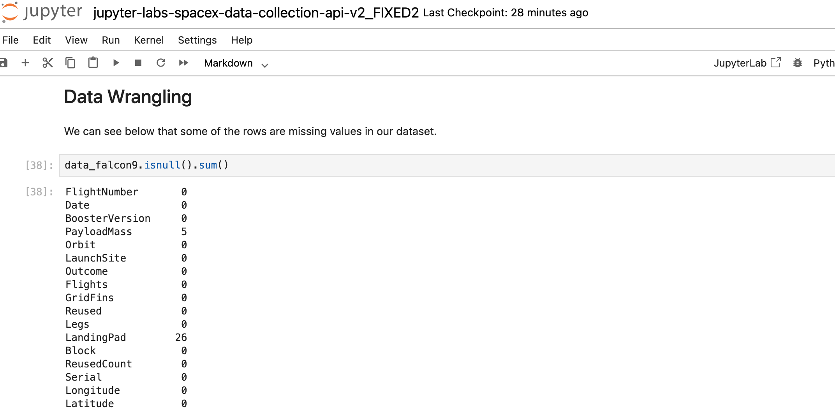
Data Wrangling
Data Processing Overview
Merged SpaceX API data with scraped Wikipedia data
Removed irrelevant and duplicate columns
Handled missing values (e.g., payload mass)
Standardized column names and formats
Data Wrangling Workflow
Raw API Data + Scraped Data
│
▼
Data Cleaning & Validation
│
▼
Feature Engineering
│
▼
Model-Ready Dataset
Key Wrangling Steps
Converted categorical variables using One-Hot Encoding
Extracted launch year from date field
Cast all numerical features to float64
Verified data consistency and integrity

Slide 12
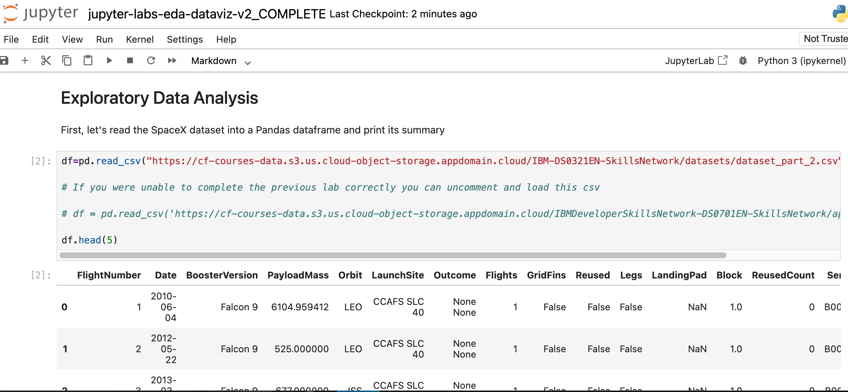
EDA with Data Visualization
Charts Used:
Scatter Plots
Flight Number vs. Launch Site
Payload Mass vs. Launch Site
Flight Number vs. Orbit Type
Payload Mass vs. Orbit Type
Bar Charts
Success Rate by Orbit Type
Line Charts
Yearly Average Launch Success Rate
Why These Charts Were Used
Scatter plots reveal relationships between numerical and categorical variables and help identify trends and clustering of successful vs. failed launches.
Bar charts effectively compare success rates across discrete orbit categories.
Line charts highlight temporal trends and long-term improvements in launch success over time.
Key Insights from Visualization
Launch success increases with higher flight numbers, indicating improved reliability.
Certain orbit types (LEO, ISS, Polar) show consistently higher success rates.
Payload mass influences success differently depending on orbit type.
Launch success has steadily increased since 2013.

Slide 13
EDA with SQL
SQL Queries Performed (SQLite):
Retrieved basic records and limited outputs
Displayed up to 20 records using LIMIT
Identified launch site patterns
Listed unique launch sites
Filtered launch sites beginning with “CCA”
Computed payload statistics
Calculated total payload mass carried by boosters for NASA (CRS)
Found average payload mass for booster version F9 v1.1
Found minimum and maximum payload mass using MIN() / MAX()
Analyzed landing outcomes
Found the first successful ground landing date
Listed boosters with successful drone ship landings and payload mass between 4000 and 6000
Counted total successful vs failed mission outcomes
Ranked landing outcomes (e.g., Success/Failure types) between 2010-06-04 and 2017-03-20
Explored booster performance
Identified booster version(s) that carried the maximum payload mass
Time-based filtering
Retrieved 2015 failed drone ship landing records with booster version and launch site
Extracted month values using substr(Date, 6, 2) for SQLite compatibility

Slide 14
Build an Interactive Map with Folium
Map Objects Created:
Markers
Plotted all SpaceX launch site locations on a global map
Circle Markers
Color-coded launches based on outcome (Success / Failure)
Lines
Drew distance lines from launch sites to nearby infrastructure
Distance Labels
Displayed calculated distances to coastlines, highways, and railways
Why These Objects Were Added:
Markers provide clear geographic context for SpaceX launch sites
Circle markers visually distinguish successful and failed launches
Lines and distance calculations help analyze proximity to key infrastructure
Interactive popups allow users to explore launch details dynamically
Key Techniques
Launch sites are strategically located near coastlines for safety
Proximity to transportation infrastructure supports logistics efficiency
Certain sites show higher success concentration patterns

Slide 15
Build a Dashboard with Plotly Dash
Dashboard Components Added:
Pie Charts
Launch success vs. failure counts for all launch sites
Success rate for individual launch sites
Scatter Plot
Payload Mass vs. Launch Outcome
Interactive Controls
Dropdown menu to select launch sites
Range slider to filter payload mass
Why These Plots and Interactions Were Added:
Pie charts provide a clear summary of launch success distribution
Scatter plots reveal relationships between payload mass and launch outcomes
Dropdown filters allow site-specific performance comparison
Range sliders enable dynamic analysis across payload mass ranges
Key Techniques
Certain launch sites show higher success ratios
Higher payload ranges impact success differently depending on site
Interactive filtering supports deeper exploratory analysis

Slide 16
Predictive Analysis (Classification)
Model Development Process:
Defined target variable: Launch Success (Class)
Selected relevant numerical and encoded categorical features
Split data into training and testing sets with stratification
Scaled features for model consistency
Classification Models Built:
Logistic Regression
Support Vector Machine (SVM)
Decision Tree
K-Nearest Neighbors (KNN)
Model Optimization and Evaluation:
Applied GridSearchCV for hyperparameter tuning
Evaluated models using accuracy score
Compared performance across multiple classifiers
Analyzed confusion matrices to assess prediction errors
Best Performing Model
Support Vector Machine (RBF kernel) and Decision Tree achieved highest test accuracy
Best accuracy observed: ~83–93%
Model Development Flow
Feature Selection
│
▼
Train / Test Split
│
▼
Model Training
│
▼
Hyperparameter Tuning
│
▼
Model Evaluation & Selection

Slide 17
Results
Exploratory Data Analysis Results:
Launch success rates increase with flight number, showing operational learning over time
Payload mass and orbit type significantly influence launch outcomes
LEO, ISS, and Polar orbits show higher success rates compared to GTO
Launch success has steadily improved since 2013, reaching peak levels by 2020
Interactive Analytics:
Folium maps reveal strategic launch site locations near coastlines and infrastructure
Color-coded markers highlight success vs. failure spatial patterns
Plotly Dash dashboard enables dynamic filtering by launch site and payload range
Interactive controls uncover site-specific and payload-specific success trends
Predictive Analysis Results:
Multiple classification models were evaluated for launch success prediction
SVM (RBF kernel) and Decision Tree achieved the highest test accuracy
Best observed accuracy: ~83–93%
Confusion matrix analysis confirms strong predictive performance with minimal misclassification
Key Takeaway:
Combining exploratory analysis, interactive visualization, and machine learning provides strong predictive insight into SpaceX Falcon 9 launch success.

Slide 18

Section 2

Slide 19
Flight Number vs. Launch Site
What the Chart Shows:
Scatter plot of Flight Number (x-axis) versus Launch Site (y-axis)
Points are colored by launch outcome (Success / Failure)
Key Observations:
Early flights show a higher concentration of failed launches across multiple sites
As flight number increases, launches become predominantly successful
Later missions cluster at higher flight numbers with very few failures
Some launch sites appear only in later flight numbers, coinciding with higher success rates
Insight:
Launch success improves as SpaceX gains experience over time
Operational learning and technology refinement contribute to improved outcomes
Flight number is a strong indicator of mission reliability

Slide 20
Payload vs. Launch Site
What the Chart Shows:
Scatter plot of Payload Mass (kg) on the x-axis versus Launch Site on the y-axis
Points are colored by launch outcome (Success / Failure)
Key Observations:
Successful launches are more frequent at higher payload masses for certain launch sites
Some launch sites support heavier payload missions with higher success rates
Failed launches tend to cluster at lower payload masses, particularly in earlier missions
Payload capacity and performance vary by launch site
Insight:
Payload mass plays a significant role in launch success, but its impact depends on the launch site
Certain sites are better equipped to handle heavier payloads reliably

Slide 21
Success Rate vs. Orbit Type
What the Chart Shows:
Bar chart displaying the average launch success rate for each orbit type
Success rate is calculated as the mean of the Class variable (1 = Success, 0 = Failure)
Key Observations:
LEO, ISS, and Polar orbits exhibit the highest success rates
These orbit types show consistent performance with very few failures
GTO missions display a lower and more variable success rate
Differences in success rates highlight the varying complexity of orbit missions
Insight:
Orbit type is a strong indicator of launch success
Missions targeting higher-energy or more complex orbits (e.g., GTO) are more challenging

Slide 22
Flight Number vs. Orbit Type
What the Chart Shows:
Scatter plot of Flight Number on the x-axis versus Orbit Type on the y-axis
Points are color-coded by launch outcome (Success / Failure)
Key Observations:
Early flight numbers are associated with a wider range of orbit types and more failures
As flight number increases, launches become more consistently successful across most orbit types
Certain orbit types appear only at higher flight numbers, indicating they were attempted after gaining experience
Failures become increasingly rare in later missions
Insight:
SpaceX’s ability to successfully complete missions across different orbit types improves with experience
Flight number serves as a proxy for technological and operational maturity

Slide 23
Payload vs. Orbit Type
What the Chart Shows:
Scatter plot of Payload Mass (kg) on the x-axis versus Orbit Type on the y-axis
Points are color-coded by launch outcome (Success / Failure)
Key Observations:
Polar, LEO, and ISS orbits show a high concentration of successful launches at higher payload masses
These orbit types demonstrate greater reliability even as payload mass increases
GTO missions display both successful and unsuccessful outcomes across a wide payload range
There is no clear payload threshold for success in GTO missions
Insight:
Payload mass impacts launch success differently depending on orbit type
Higher-energy orbits (GTO) are more challenging and less predictable

Slide 24
Launch Success Yearly Trend
What the Chart Shows:
Line chart displaying the yearly average launch success rate
Success rate is calculated as the mean of the Class variable (1 = Success, 0 = Failure)
Key Observations:
Launch success rates were inconsistent prior to 2013
From 2013 onward, success rates show a steady and sustained increase
By 2020, launch success approaches near-perfect levels
The upward trend reflects continuous operational improvement
Insight:
SpaceX launch reliability improves significantly over time
Advances in technology, reuse strategies, and experience contribute to higher success rates

Slide 25
All Launch Site Names
What the Query Shows:
SQL query was used to retrieve the distinct launch site names from the SpaceX dataset
The query identifies all unique launch locations used for Falcon 9 missions
Query Result:
The SpaceX dataset contains the following unique launch sites:
CCAFS LC-40
CCAFS SLC-40
KSC LC-39A
VAFB SLC-4E
Explanation:
SpaceX launches missions from multiple geographically distinct sites
Each site supports different mission profiles and orbital requirements
The presence of multiple launch sites highlights operational flexibility and scalability

Slide 26
Launch Site Names Begin with 'CCA'
What the Query Shows:
SQL query filters launch sites where the name begins with “CCA”
Used pattern matching to isolate Cape Canaveral Air Force Station launch sites
Query Result:
The following launch sites begin with “CCA”:
CCAFS LC-40
CCAFS SLC-40
Explanation:
These launch sites are located at Cape Canaveral Air Force Station
They are among the most frequently used SpaceX launch locations
Multiple naming conventions reflect historical and operational variations

Slide 27
Total Payload Mass
What the Query Shows:
SQL query calculates the total payload mass carried by SpaceX boosters
Aggregation performed using the SUM() function on payload mass values
Focused on missions conducted for NASA (CRS missions)
Query Result:
The query returns the combined payload mass (kg) delivered by SpaceX boosters for NASA missions
Explanation:
SpaceX has successfully transported a significant cumulative payload mass to orbit
Demonstrates SpaceX’s growing role in reliable cargo delivery for NASA
Highlights long-term operational capability rather than single-mission performance

Slide 28
Average Payload Mass by F9 v1.1
What the Query Shows:
SQL query calculates the average payload mass carried by booster version F9 v1.1
Used the AVG() aggregate function to compute mean payload mass
Query Result:
The result represents the typical payload capacity (kg) for Falcon 9 v1.1 missions
Explanation:
Falcon 9 v1.1 was a key transitional booster in SpaceX’s launch evolution
The average payload mass reflects its operational capability during early reuse development
Provides a benchmark for comparing newer booster versions

Slide 29
First Successful Ground Landing Date
What the Query Shows:
SQL query identifies the earliest date of a successful ground pad landing
Used the MIN() function on the launch date
Filtered records where landing outcome indicates Success (ground pad)
Query Result:
The query returns the first successful ground landing date achieved by SpaceX
Explanation:
This milestone represents SpaceX’s first successful booster recovery on land
Marks a critical breakthrough in reusability and cost reduction
Demonstrates a turning point in SpaceX’s operational maturity

Slide 30
Successful Drone Ship Landing with Payload between 4000 and 6000
What the Query Shows:
SQL query identifies boosters that successfully landed on a drone ship
Filters launches with payload mass between 4000 kg and 6000 kg
Ensures only successful landing outcomes are included
Query Result:
The query returns the names of boosters that:
Landed successfully on a drone ship
Carried medium-to-heavy payloads (4000–6000 kg)
Explanation:
Drone ship landings are more complex than ground landings
Successful recovery at this payload range demonstrates:
Strong booster performance
Precision landing capability under higher mission stress
These missions represent an important step toward routine reusability

Slide 31
Total Number of Successful and Failure Mission Outcomes
What the Query Shows:
SQL query counts the total number of successful and failed missions
Used the COUNT() function grouped by Mission Outcome
Provides an overall distribution of launch performance
Query Result:
The result shows the total number of successful missions versus failed missions
Successful outcomes significantly outnumber failures in the dataset
Explanation:
The high number of successful missions reflects SpaceX’s improving reliability
Failures are concentrated in earlier missions, while later launches show consistent success
This confirms trends observed in visualization-based EDA

Slide 32
Boosters Carried Maximum Payload
What the Query Shows:
SQL query identifies the booster version(s) that carried the maximum payload mass
Used a subquery with MAX() to find the highest payload value
Returned booster names associated with that payload
Query Result:
The result lists the booster version(s) that achieved the highest payload capacity in the dataset
Explanation:
These boosters represent SpaceX’s highest-performing configurations
Carrying maximum payloads requires advanced propulsion, structural integrity, and mission planning
Demonstrates technological progress across booster versions

Slide 33
2015 Launch Records
What the Query Shows:
SQL query retrieves failed drone ship landing outcomes
Filtered records for the year 2015
Displays:
Booster version
Launch site
Landing outcome
Query Result:
The result lists 2015 launches where:
Landing outcome was Failure (drone ship)
Associated booster versions and launch sites are shown
Explanation:
2015 represents an early experimental phase of drone ship landings
Failures during this period reflect the learning curve of precision landings at sea
These challenges contributed to improvements seen in later years

Slide 34
Rank Landing Outcomes Between 2010-06-04 and 2017-03-20
What the Query Shows:
SQL query ranks the count of landing outcomes within the specified date range
Includes outcomes such as:
Success (ground pad)
Success (drone ship)
Failure (drone ship)
Results are ordered in descending frequency
Query Result:
The ranking shows which landing outcomes occurred most frequently during early SpaceX missions
Failure outcomes appear more frequently in earlier years, while successes increase over time
Explanation:
Early missions experienced higher failure rates, especially for drone ship landings
As SpaceX refined landing technology, successful landings became dominant
This ranking quantitatively confirms the learning curve effect

Slide 35

Section 3

Slide 36
<Folium Map Screenshot 1>
Replace <Folium map screenshot 1> title with an appropriate title
Explore the generated folium map and make a proper screenshot to include all launch sites’ location markers on a global map
Explain the important elements and findings on the screenshot

Slide 37
<Folium Map Screenshot 2>
Replace <Folium map screenshot 2> title with an appropriate title
Explore the folium map and make a proper screenshot to show the color-labeled launch outcomes on the map
Explain the important elements and findings on the screenshot

Slide 38
<Folium Map Screenshot 3>
Replace <Folium map screenshot 3> title with an appropriate title
Explore the generated folium map and show the screenshot of a selected launch site to its proximities such as railway, highway, coastline, with distance calculated and displayed
Explain the important elements and findings on the screenshot

Slide 39

Section 4

Slide 40
<Dashboard Screenshot 1>
Replace <Dashboard screenshot 1> title with an appropriate title
Show the screenshot of launch success count for all sites, in a piechart
Explain the important elements and findings on the screenshot

Slide 41
<Dashboard Screenshot 2>
Replace <Dashboard screenshot 2> title with an appropriate title
Show the screenshot of the piechart for the launch site with highest launch success ratio
Explain the important elements and findings on the screenshot

Slide 42
<Dashboard Screenshot 3>
Replace <Dashboard screenshot 3> title with an appropriate title
Show screenshots of Payload vs. Launch Outcome scatter plot for all sites, with different payload selected in the range slider
Explain the important elements and findings on the screenshot, such as which payload range or booster version have the largest success rate, etc.

Slide 43

Section 5

Slide 44
Classification Accuracy
Visualize the built model accuracy for all built classification models, in a bar chart
Find which model has the highest classification accuracy

Slide 45
Confusion Matrix
Show the confusion matrix of the best performing model with an explanation

Slide 46
Conclusions
Point 1
Point 2
Point 3
Point 4
…

Slide 47
Appendix
Include any relevant assets like Python code snippets, SQL queries, charts, Notebook outputs, or data sets that you may have created during this project

Slide 48


